Slide 1

HANGMAN GAME MINI PROJECT " A WEB BASED WORD GUESSING ADVENTURE "
PRESENTED BY :-
UTKARSH JOSHI
BHUMIKA PANDEY
HARSHITA JOSHI

Slide 2
PRESENTATION CONTENT
INTRODUCTION | BRIEF OVERVIEW OF HANGMAN GAME PROJECT AND ITS SIGNIFICANCE
PROJECT OBJECTIVES | GOALS AND OBJECTIVES OF THE HANGMAN PROJECT
FEATURES OVERVIEW | MAIN START GAME GUESS THE WORD RESULT CONTINUE OR QUIT
LANGUAGE AND SOFTWARE USED | LANGUAGES USED SOFTWARE USED
FUTURE ENHANCEMENT | POTENTIAL FEATURES OR IMPROVEMENTS FOR THE FUTURE
CONCLUSION | KEY POINTS OF THE WHOLE PROJECT

Slide 3
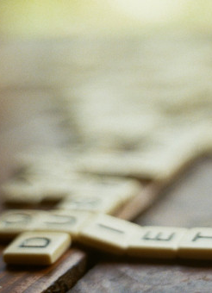
INTRODUCTION
Welcome to "The Hangman", a delightful project that brings the classic word-guessing game to life in a modern and interactive way. This project combines the fundamentals of web development – HTML, CSS, and JavaScript – to create an engaging and visually appealing user experience.
"The Hangman" is a web-based game where players guess a hidden word one letter at a time. The game features a diverse set of words, each accompanied by a hint to provide a clue about the mystery word. Players have a limited number of incorrect guesses before the hangman is fully drawn, making each attempt crucial to their success.

Slide 4


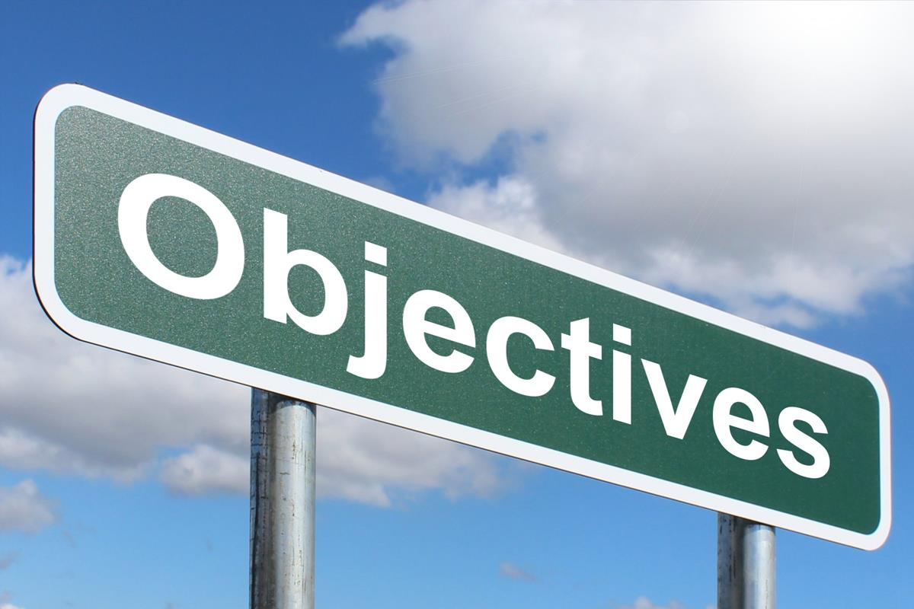



Implementation of a Hangman Game: Develop a web-based Hangman game using HTML, CSS, and JavaScript.
User Interaction: Enable user interaction by providing a responsive and engaging interface for playing the game.
Random Word Selection: Implement a mechanism to randomly select words.
Game Logic: Implement the core game logic, including word display, letter guessing, and tracking the number of attempts.
Avoidance of Alerts and Prompts: Refine the user experience by removing alert and prompt messages, replacing them with more seamless and user-friendly interactions.
Play Again Feature: Include a feature allowing users to play the game again with a new word after completing or losing a game.
Visual Appeal: Enhance the visual appeal of the game interface using CSS styling.
Integration of Multiple Technologies: Demonstrate the integration of HTML, CSS, and JavaScript to create a cohesive and interactive web application.
Responsive Design: Ensure the game is accessible and visually appealing across various devices and screen sizes.
User Guidance: Provide clear instructions and information to guide users on the game's rules, category, and their progress.

Slide 5

FEATURES OVERVIEW

Slide 6
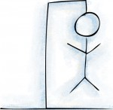
Responsive Design: The game is designed to be accessible and enjoyable across various devices, from desktops to mobile phones.
Dynamic UI Elements: The user interface dynamically updates as players make guesses, displaying the progress, incorrect guesses, and the hangman image.
Modal for Game Over: Upon winning or losing, a modal window appears, revealing whether the player successfully guessed the word or if the hangman met his fate.
Random Word Selection: The game selects words randomly from different categories, adding an element of surprise and variety to each playthrough.

Slide 7
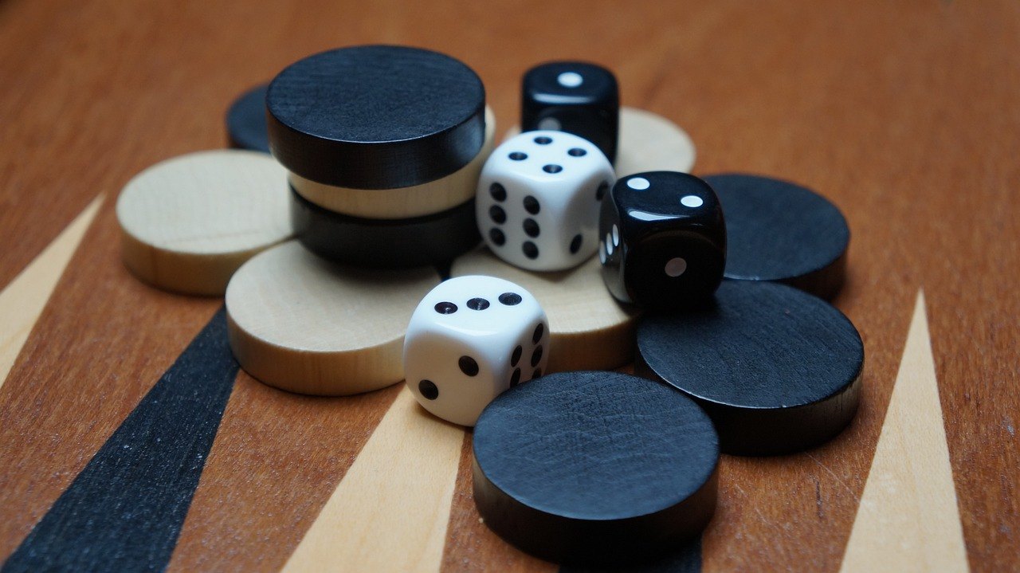
GAME LOGIC

Slide 8

GAME LOGIC:
o
Mini project
01
02
03
04
05
Main
Start
game
Guess the word
result
Play again or quit
A web page is visible in which a message and start button is visible to the player.
The player can press the start button to play the game
Number of letters and category will be given and Player will guess it.
If guess is correct you'll win otherwise you'll loose
Play again or quit

Slide 9

LANGUAGE AND SOFTWARE USED

Slide 10

LANGUAGES USED
HTML :
Hyper Text markup language, is a markup language for the web that defines the structure of the web-page. It is one of the basic building block for every website.
​
CSS :
CSS (Cascading Style Sheets) is a style sheet language used to describe the presentation of a document written in HTML or XML. It defines how elements on a web page should be displayed, specifying styles such as layout, colors, fonts, and spacing. CSS allows web developers to separate the structure of a document from its visual presentation, promoting cleaner and more maintainable code.
JAVA SCRIPT :
It is most well known as the scripting language for web pages, many non-browser environments also use it, such as Node.js, Adobe acrobat etc. JavaScript is not "Interpreted java". Both programming language have very different syntax, semantics and uses​.

Slide 11

SOFTWARE USED
VS Code : Visual studio code is a source code editor developed by Microsoft for Windows , Linux and MacOS.
Features include support for debugging , syntax highlighting, intelligent code completion , snippets, code refactoring and embedded Git.

Slide 12

FUTURE ENHANCEMENT

Slide 13

FUTURE ENHANCEMENT
Some of the enhancements that we want to introduce in this project are :-
Multiplayer mode :- To add a feature that will allow players to play against each other in real time.
Difficulty levels :- To Implement different difficulty levels , such as easy , medium, and hard.
Leaderboards and achievements :- To create leaderboard to track high scores and achievements.

Slide 14

CONCLUSION
The hangman game project was successfully implemented and accomplished its objectives.
The game provides an enjoyable and interactive experience for users , challenging their word guessing skills.
The user interface is user-friendly and intuitive , allowing players to easily navigate and interact with the game
Overall , the Hangman game project is a fun and engaging way to pass he time while improving vocabulary and spelling skills.

Slide 15


